Slide 1

Cryptographic Hashes and MACs
CSE 405 July 2023
Lecture 5

Slide 2
Last Time: Block Ciphers
Encryption: input a k-bit key and n-bit plaintext, receive n-bit ciphertext
Decryption: input a k-bit key and n-bit ciphertext, receive n-bit plaintext
Correctness: when the key is fixed, EK(M) should be bijective
Security
Without the key, EK(m) is computationally indistinguishable from a random permutation
Brute-force attacks take astronomically long and are not possible
Efficiency: algorithms use XORs and bit-shifting (very fast)
Implementation: AES is the modern standard
Issues
Not IND-CPA secure because they’re deterministic
Can only encrypt n-bit messages

Slide 3
Last Time: Block Cipher Modes of Operation
ECB mode: Deterministic, so not IND-CPA secure
CBC mode
IND-CPA secure, assuming no IV reuse
Encryption is not parallelizable
Decryption is parallelizable
Must pad plaintext to a multiple of the block size
IV reuse leads to leaking the existence of identical blocks at the start of the message
CTR mode
IND-CPA secure, assuming no IV reuse
Encryption and decryption are parallelizable
Plaintext does not need to be padded
Nonce reuse leads to losing all security
Lack of integrity and authenticity

Slide 4

Lack of Integrity and Authenticity
Block ciphers are designed for confidentiality (IND-CPA)
If an attacker tampers with the ciphertext, we are not guaranteed to detect it
Remember Mallory: An active manipulator who wants to tamper with the message

Slide 5
Lack of Integrity and Authenticity
Consider CTR mode
What if Mallory tampers with the ciphertext using XOR?
P | a | y |  | M | a | l |  | $ | 1 | 0 | 0
0x50 | 0x61 | 0x79 | 0x20 | 0x4d | 0x61 | 0x6c | 0x20 | 0x24 | 0x31 | 0x30 | 0x30
M
⊕
EK(i)
0x8a | 0xe3 | 0x5e | 0xcf | 0x3b | 0x40 | 0x46 | 0x57 | 0xb8 | 0x69 | 0xd2 | 0x96
=
C
0xda | 0x82 | 0x27 | 0xef | 0x76 | 0x21 | 0x2a | 0x77 | 0x9c | 0x58 | 0xe2 | 0xa6

Slide 6
Lack of Integrity and Authenticity
Suppose Mallory knows the message M
How can Mallory change the M to say Pay Mal $900?
P | a | y |  | M | a | l |  | $ | 1 | 0 | 0
0x50 | 0x61 | 0x79 | 0x20 | 0x4d | 0x61 | 0x6c | 0x20 | 0x24 | 0x31 | 0x30 | 0x30
M
⊕
EK(i)
0x8a | 0xe3 | 0x5e | 0xcf | 0x3b | 0x40 | 0x46 | 0x57 | 0xb8 | 0x69 | 0xd2 | 0x96
=
C
0xda | 0x82 | 0x27 | 0xef | 0x76 | 0x21 | 0x2a | 0x77 | 0x9c | 0x58 | 0xe2 | 0xa6

Slide 7
Lack of Integrity and Authenticity
Ci | = | Mi ⊕ Padi | 0x58 | = | 0x31 ⊕ Padi | Definition of CTR
Padi | = | Mi ⊕ Ci | Padi | = | 0x58 ⊕ 0x31 | Solve for the ith byte of the pad
 |  |  |  | = | 0x69
C'i | = | M'i ⊕ Padi | C'i | = | 0x39 ⊕ 0x69 | Compute the changed ith byte
 |  |  |  | = | 0x50
C
0xda | 0x82 | 0x27 | 0xef | 0x76 | 0x21 | 0x2a | 0x77 | 0x9c | 0x58 | 0xe2 | 0xa6
C’
0xda | 0x82 | 0x27 | 0xef | 0x76 | 0x21 | 0x2a | 0x77 | 0x9c | 0x50 | 0xe2 | 0xa6

Slide 8
Lack of Integrity and Authenticity
What happens when we decrypt C'?
The message looks like “Pay Mal $900” now!
Note: Mallory didn’t have to know the key; no integrity or authenticity for CTR mode!
C'
0xda | 0x82 | 0x27 | 0xef | 0x76 | 0x21 | 0x2a | 0x77 | 0x9c | 0x50 | 0xe2 | 0xa6
⊕
EK(i)
0x8a | 0xe3 | 0x5e | 0xcf | 0x3b | 0x40 | 0x46 | 0x57 | 0xb8 | 0x69 | 0xd2 | 0x96
=
P'
0x50 | 0x61 | 0x79 | 0x20 | 0x4d | 0x61 | 0x6c | 0x20 | 0x24 | 0x39 | 0x30 | 0x30
P | a | y |  | M | a | l |  | $ | 9 | 0 | 0

Slide 9
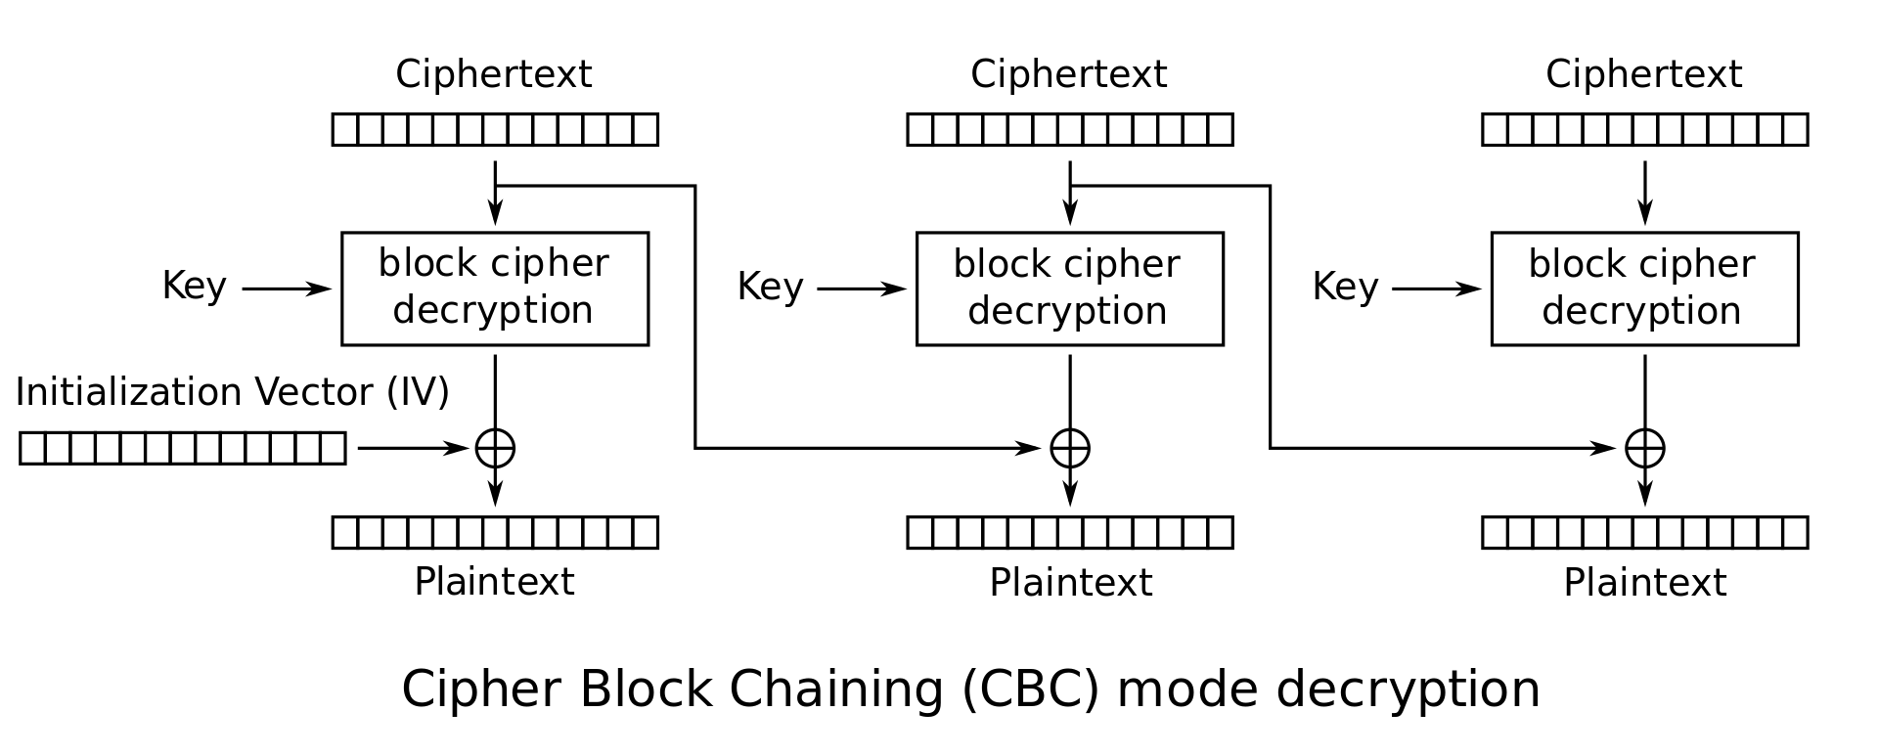
Lack of Integrity and Authenticity
What about CBC?
Altering a bit of the ciphertext causes some blocks to become random gibberish
However, Bob cannot prove that Alice did not send random gibberish, so it still does not provide integrity or authenticity

Slide 10
Today: Cryptography Hashes and MACs
Hashing
Definition
Security: one-way, second preimage resistant, collision resistant
Examples
Length extension attacks
Application: Lowest-hash scheme
Do hashes provide integrity?
MACs
Definition
Security: unforgeability
Example: HMAC
Do MACs provide integrity?
Authenticated Encryption
Definition
Key Reuse
MAC-then-Encrypt or Encrypt-then-MAC?
AEAD Encryption Modes

Slide 11

Cryptographic Hashes
Textbook Chapter 7.1–7.3

Slide 12
Cryptography Roadmap
 | Symmetric-key | Asymmetric-key
Confidentiality | One-time pads Block ciphers with chaining modes (e.g. AES-CBC) | RSA encryption ElGamal encryption
Integrity, Authentication | MACs (e.g. HMAC) | Digital signatures (e.g. RSA signatures)
Hash functions
Pseudorandom number generators
Public key exchange (e.g. Diffie-Hellman)
Key management (certificates)
Password management

Slide 13
Cryptographic Hash Function: Definition
Hash function: H(M)
Input: Arbitrary length message M
Output: Fixed length, n-bit hash
Sometimes written as {0, 1}* → {0, 1}^{n}
Properties
Correctness: Deterministic
Hashing the same input always produces the same output
Efficiency: Efficient to compute
Security: One-way-ness (“preimage resistance”)
Security: Collision-resistance
Security: Random/unpredictability, no predictable patterns for how changing the input affects the output
Changing 1 bit in the input causes the output to be completely different
Also called “random oracle” assumption

Slide 14
Hash Function: Intuition
A hash function provides a fixed-length “fingerprint” over a sequence of bits
Example: Document comparison
If Alice and Bob both have a 1 GB document, they can both compute a hash over the document and (securely) communicate the hashes to each other
If the hashes are the same, the files must be the same, since they have the same “fingerprint”
If the hashes are different, the files must be different

Slide 15
Hash Function: One-way-ness or Preimage Resistance
Informal: Given an output y, it is infeasible to find any input x such that H(x) = y
More formally: For all polynomial time adversary,
Pr[x chosen randomly from plaintext space; y = H(x):
Adv(y) outputs x' s.t. H(x') = y] is negligible
Intuition: Here’s an output. Can you find an input that hashes to this output?
Note: The adversary just needs to find any input, not necessarily the input that was actually used to generate the hash
Example: Is H(x) = 1 one-way?
No, because given output 1, an attacker can return any number x

Slide 16
Hash Function: Collision Resistance
Collision: Two different inputs with the same output
x ≠ x' and H(x) = H(x')
Can we design a hash function with no collisions?
No, because there are more inputs than outputs (pigeonhole principle)
However, we want to make finding collisions infeasible for an attacker
Collision resistance: It is infeasible to (i.e. no polynomial time attacker can) find any pair of inputs x' ≠ x such that H(x) = H(x')
Intuition: Can you find any two inputs that collide with the same hash output for any output?

Slide 17

Hash Function: Collision Resistance
Birthday attack: Finding a collision on an n-bit output requires only 2^{n/2} tries on average
This is why a group of 23 people are >50% likely to have at least one birthday in common

Slide 18
Hash Function: Examples
MD5
Output: 128 bits
Security: Completely broken
SHA-1
Output: 160 bits
Security: Completely broken in 2017
Was known to be weak before 2017, but still used sometimes
SHA-2
Output: 256, 384, or 512 bits (sometimes labeled SHA-256, SHA-384, SHA-512)
Not currently broken, but some variants are vulnerable to a length extension attack
Current standard
SHA-3 (Keccak)
Output: 256, 384, or 512 bits
Current standard (not meant to replace SHA-2, just a different construction)
A GIF that displays its own MD5 hash
Notes:
SHA-3 has better length extension attack resilience than SHA-2. SHA-2 is faster.

Slide 19
Length Extension Attacks
Length extension attack: Given H(x) and the length of x, but not x, an attacker can create H(x || m) for any m of the attacker’s choosing
Note: This doesn’t violate any property of hash functions but is undesirable in some circumstances
SHA-256 (256-bit version of SHA-2) is vulnerable
SHA-3 is not vulnerable

Slide 20
Do hashes provide integrity?
It depends on your threat model
Scenario
Mozilla publishes a new version of Firefox on some download servers
Alice downloads the program binary
How can she be sure that nobody tampered with the program?
Idea: use cryptographic hashes
Mozilla hashes the program binary and publishes the hash on its website
Alice hashes the binary she downloaded and checks that it matches the hash on the website
If Alice downloaded a malicious program, the hash would not match (tampering detected!)
An attacker can’t create a malicious program with the same hash (collision resistance)
Threat model: We assume the attacker cannot modify the hash on the website
We have integrity, as long as we can communicate the hash securely

Slide 21
Do hashes provide integrity?
It depends on your threat model
Scenario
Alice and Bob want to communicate over an insecure channel
Mallory might tamper with messages
Idea: Use cryptographic hashes
Alice sends her message with a cryptographic hash over the channel
Bob receives the message and computes a hash on the message
Bob checks that the hash he computed matches the hash sent by Alice
Threat model: Mallory can modify the message and the hash
No integrity!

Slide 22
Do hashes provide integrity?
It depends on your threat model
If the attacker can modify the hash, hashes don’t provide integrity
Main issue: Hashes are unkeyed functions
There is no secret key being used as input, so any attacker can compute a hash on any value
Next: Use hashes to design schemes that provide integrity

Slide 23

Message Authentication Codes (MACs)
Textbook Chapter 8.1–8.3 & 8.5–8.6

Slide 24
Cryptography Roadmap
 | Symmetric-key | Asymmetric-key
Confidentiality | One-time pads Block ciphers with chaining modes (e.g. AES-CBC) | RSA encryption ElGamal encryption
Integrity, Authentication | MACs (e.g. HMAC) | Digital signatures (e.g. RSA signatures)
Hash functions
Pseudorandom number generators
Public key exchange (e.g. Diffie-Hellman)
Key management (certificates)
Password management

Slide 25
How to Provide Integrity
Reminder: We’re still in the symmetric-key setting
Assume that Alice and Bob share a secret key, and attackers don’t know the key
We want to attach some piece of information to prove that someone with the key sent this message
This piece of information can only be generated by someone with the key

Slide 26
MACs: Usage
Alice wants to send M to Bob, but doesn’t want Mallory to tamper with it
Alice sends M and T = MAC(K, M) to Bob
Bob receives M and T
Bob computes MAC(K, M) and checks that it matches T
If the MACs match, Bob is confident the message has not been tampered with (integrity)
Alice
Key
Insecure Channel
Key
Bob
Message
MAC
Message
Verify
Message
T

Slide 27
MACs: Definition
Two parts:
KeyGen() → K: Generate a key K
MAC(K, M) → T: Generate a tag T for the message M using key K
Inputs: A secret key and an arbitrary-length message
Output: A fixed-length tag on the message
Properties
Correctness: Determinism
Note: Some more complicated MAC schemes have an additional Verify(K, M, T) function that don’t require determinism, but this is out of scope
Efficiency: Computing a MAC should be efficient
Security: EU-CPA (existentially unforgeable under chosen plaintext attack)

Slide 28
Defining Integrity: EU-CPA
A secure MAC is existentially unforgeable: without the key, an attacker cannot create a valid tag on a message
Mallory cannot generate MAC(K, M') without K
Mallory cannot find any M' ≠ M such that MAC(K, M') = MAC(K, M)
Formally defined by a security game: existential unforgeability under chosen-plaintext attack, or EU-CPA
MACs should be unforgeable under chosen plaintext attack
Intuition: Like IND-CPA, but for integrity and authenticity
Even if Mallory can trick Alice into creating MACs for messages that Mallory chooses, Mallory cannot create a valid MAC on a message that she hasn't seen before

Slide 29
Defining Integrity: EU-CPA
Mallory (adversary)
Alice (challenger)
Mallory may send messages to Alice and receive their tags
Eventually, Mallory creates a message-tag pair (M', T')
M' cannot be a message that Mallory requested earlier
If T' is a valid tag for M', then Mallory wins. Otherwise, she loses.
A scheme is EU-CPA secure if for all polynomial time adversaries, the probability of winning is 0 or negligible
M
(repeat)
MAC(K, M)
Output (M', T')

Slide 30
Example: NMAC
Can we use secure cryptographic hashes to build a secure MAC?
Intuition: Hash output is unpredictable and looks random, so let’s hash the key and the message together
KeyGen():
Output two random, n-bit keys K1 and K2, where n is the length of the hash output
NMAC(K1, K2, M):
Output H(K1 || H(K2 || M))
NMAC is EU-CPA secure if the two keys are different
Provably secure if the underlying hash function is secure
Intuition: Using two hashes prevents a length extension attack
Otherwise, an attacker who sees a tag for M could generate a tag for M || M'

Slide 31
Example: HMAC
Issues with NMAC:
Recall: NMAC(K1, K2, M) = H(K1 || H (K2 || M))
We need two different keys
NMAC requires the keys to be the same length as the hash output (n bits)
Can we use NMAC to design a scheme that uses one key?
HMAC(K, M):
Compute K' as a version of K that is the length of the hash output
If K is too short, pad K with 0’s to make it n bits (be careful with keys that are too short and lack randomness)
If K is too long, hash it so it’s n bits
Output H((K' ⊕ opad) || H((K' ⊕ ipad) || M))

Slide 32
Example: HMAC
HMAC(K, M):
Compute K' as a version of K that is the length of the hash output
If K is too short, pad K with 0’s to make it n bits (be careful with keys that are too short and lack randomness)
If K is too long, hash it so it’s n bits
Output H((K' ⊕ opad) || H((K' ⊕ ipad) || M))
Use K' to derive two different keys
opad (outer pad) is the hard-coded byte 0x5c repeated until it’s the same length as K'
ipad (inner pad) is the hard-coded byte 0x36 repeated until it’s the same length as K'
As long as opad and ipad are different, you’ll get two different keys
For paranoia, the designers chose two very different bit patterns, even though they theoretically need only differ in one bit

Slide 33
HMAC Properties
HMAC(K, M) = H((K' ⊕ opad) || H((K' ⊕ ipad) || M))
HMAC is a hash function, so it has the properties of the underlying hash too
It is collision resistant
Given HMAC(K, M) and K, an attacker can’t learn M
If the underlying hash is secure, HMAC doesn’t reveal M, but it is still deterministic
You can’t verify a tag T if you don’t have K
This means that an attacker can’t brute-force the message M without knowing K
Notes:
"HMAC is the best MAC construction: accept no substitutes!" ~Nick Weaver

Slide 34
Do MACs provide integrity?
Do MACs provide integrity?
Yes. An attacker cannot tamper with the message without being detected
Do MACs provide authenticity?
It depends on your threat model
If a message has a valid MAC, you can be sure it came from someone with the secret key, but you can’t narrow it down to one person
If only two people have the secret key, MACs provide authenticity: it has a valid MAC, and it’s not from me, so it must be from the other person
Do MACs provide confidentiality?
MACs are deterministic ⇒ No IND-CPA security
MACs in general have no confidentiality guarantees; they can leak information about the message
HMAC doesn’t leak information about the message, but it’s still deterministic, so it’s not IND-CPA secure

Slide 35

Authenticated Encryption
Textbook Chapter 8.7 & 8.8

Slide 36
Cryptography Roadmap
 | Symmetric-key | Asymmetric-key
Confidentiality | One-time pads Block ciphers with chaining modes (e.g. AES-CBC) | RSA encryption ElGamal encryption
Integrity, Authentication | MACs (e.g. HMAC) | Digital signatures (e.g. RSA signatures)
Hash functions
Pseudorandom number generators
Public key exchange (e.g. Diffie-Hellman)
Key management (certificates)
Password management

Slide 37
Authenticated Encryption: Definition
Authenticated encryption (AE): A scheme that simultaneously guarantees confidentiality and integrity (and authenticity, depending on your threat model) on a message
Two ways of achieving authenticated encryption:
Combine schemes that provide confidentiality with schemes that provide integrity
Use a scheme that is designed to provide confidentiality and integrity

Slide 38
Combining Schemes: Let’s design it together
You can use:
An IND-CPA encryption scheme (e.g. AES-CBC): Enc(K, M) and Dec(K, M)
An unforgeable MAC scheme (e.g. HMAC): MAC(K, M)
First attempt: Alice sends Enc(K1, M) and MAC(K2, M)
Integrity? Yes, attacker can’t tamper with the MAC
Confidentiality? No, the MAC is not IND-CPA secure
Idea: Let’s compute the MAC on the ciphertext instead of the plaintext: Enc(K1, M) and MAC(k2, Enc(K1, M))
Integrity? Yes, attacker can’t tamper with the MAC
Confidentiality? Yes, the MAC might leak info about the ciphertext, but that’s okay
Idea: Let’s encrypt the MAC too: Enc(K1, M || MAC(K2, M))
Integrity? Yes, attacker can’t tamper with the MAC
Confidentiality? Yes, everything is encrypted

Slide 39
MAC-then-Encrypt or Encrypt-then-MAC?
MAC-then-encrypt
First compute MAC(K2, M)
Then encrypt the message and the MAC together: Enc(K1, M || MAC(K2, M))
Encrypt-then-MAC
First compute Enc(K1, M)
Then MAC the ciphertext: MAC(K2, Enc(K1, M))
Which is better?
In theory, both are IND-CPA and EU-CPA secure if applied properly
MAC-then-encrypt has a flaw: You don’t know if tampering has occurred until after decrypting
Attacker can supply arbitrary tampered input, and you always have to decrypt it
Passing attacker-chosen input through the decryption function can cause side-channel leaks
Always use encrypt-then-MAC because it’s more robust to mistakes

Slide 40
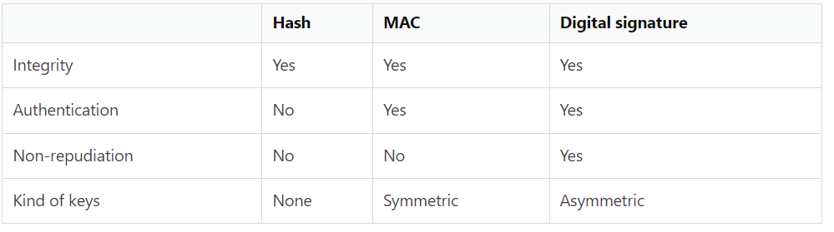
Comparison

Slide 41
TLS 1.0 “Lucky 13” Attack
TLS: A protocol for sending encrypted and authenticated messages over the Internet (we’ll study it more in the networking unit)
TLS 1.0 uses MAC-then-encrypt: Enc(K1, M || MAC(K2, M))
The encryption algorithm is AES-CBC
The Lucky 13 attack abuses MAC-then-encrypt to read encrypted messages
Guess a byte of plaintext and change the ciphertext accordingly
The MAC will error, but the time it takes to error is different depending on if the guess is correct
Attacker measures how long it takes to error in order to learn information about plaintext
TLS will send the message again if the MAC errors, so the attacker can guess repeatedly
Takeaways
Side channel attack: The algorithm is proved secure, but poor implementation made it vulnerable
Always encrypt-then-MAC
You’ll try a similar attack in Homework 2!

Slide 42
AEAD Encryption
Second method for authenticated encryption: Use a scheme that is designed to provide confidentiality, integrity, and authenticity
Authenticated encryption with additional data (AEAD): An algorithm that provides both confidentiality and integrity over the plaintext and integrity over additional data
Additional data is usually context (e.g. memory address), so you can’t change the context without breaking the MAC
Great if used correctly: No more worrying about MAC-then-encrypt
If you use AEAD incorrectly, you lose both confidentiality and integrity/authentication
Example of correct usage: Using a crypto library with AEAD
Notes:
AEAD modes are usually built for performance, which means parallelization, which means CTR mode, which means IV reuse is catastrophic!

Slide 43
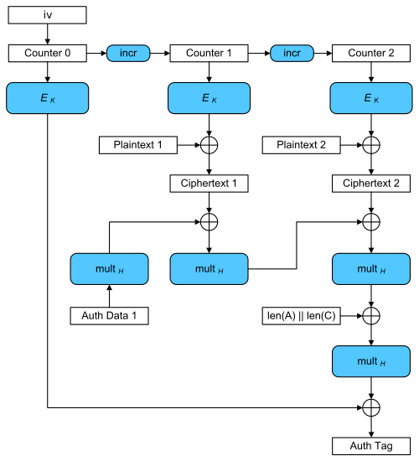
AEAD Example: Galois Counter Mode (GCM)
Galois Counter Mode (GCM): An AEAD block cipher mode of operation
EK is standard block cipher encryption
multH is 128-bit multiplication over a special field (Galois multiplication)
Don’t worry about the math
Notes:
"Not going into the details of the magic math because I don't understand it myself" ~Nick

Slide 44
AEAD Example: Galois Counter Mode (GCM)
Very fast mode of operation
Fully parallel encryption
Galois multiplication isn’t parallelizable, but it’s very fast
Drawbacks
IV reuse leads to loss of confidentiality, integrity, and authentication
This wouldn’t happen if you used AES-CTR and HMAC-SHA256
Implementing Galois implementation is difficult and easy to screw up
Takeaway: GCM provides integrity and confidentiality, but if you misuse it, it’s even worse than CTR mode

Slide 45
Hashes: Summary
Map arbitrary-length input to fixed-length output
Output is deterministic and unpredictable
Security properties
One way: Given an output y, it is infeasible to find any input x such that H(x) = y.
Second preimage resistant: Given an input x, it is infeasible to find another input x' ≠ x such that H(x) = H(x').
Collision resistant: It is infeasible to find another any pair of inputs x' ≠ x such that H(x) = H(x').
Some hashes are vulnerable to length extension attacks
Application: Lowest hash scheme
Hashes don’t provide integrity (unless you can publish the hash securely)

Slide 46
MACs: Summary
Inputs: a secret key and a message
Output: a tag on the message
A secure MAC is unforgeable: Even if Mallory can trick Alice into creating MACs for messages that Mallory chooses, Mallory cannot create a valid MAC on a message that she hasn't seen before
Example: HMAC(K, M) = H((K' ⊕ opad) || H((K' ⊕ ipad) || M))
MACs do not provide confidentiality

Slide 47
Authenticated Encryption: Summary
Authenticated encryption: A scheme that simultaneously guarantees confidentiality and integrity (and authenticity) on a message
First approach: Combine schemes that provide confidentiality with schemes that provide integrity and authenticity
MAC-then-encrypt: Enc(K1, M || MAC(K2, M))
Encrypt-then-MAC: Enc(K1, M) || MAC(K2, Enc(K1, M))
Always use Encrypt-then-MAC because it's more robust to mistakes
Second approach: Use AEAD encryption modes designed to provide confidentiality, integrity, and authenticity
Drawback: Incorrectly using AEAD modes leads to losing both confidentiality and integrity/authentication

Slide 48
Next Time
Symmetric-key encryption schemes need randomness. How do we securely generate random numbers?
When discussing symmetric-key schemes, we assumed Alice and Bob managed to share a secret key. How can Alice and Bob share a symmetric key over an insecure channel?

